Slide 1
Data Analytics
Atul Kahate

Slide 2
Basic Concepts

Slide 3
Current and Historical Data
Credit Card Transaction
Credit Card Transaction
Credit Card Transaction
Historical data of Credit Card Transactions
Credit Card Transaction
Credit Card Transaction
Credit Card Transaction
Credit Card Transaction

Slide 4

Using Data
Valid transaction?
Invalid transaction?
Amount range: 1-5000
Time: Morning
City: Pune
Reason: Shopping
Amount range: 5001-10000
Time: Afternoon
City: Mumbai
Reason: Hotel
Clusters
Amount range: 10000-25000
Time: Evening
City: Delhi
Reason: Bill Pymt
Amount range > 25001
Time: Night
City: Other
Reason: Online

Slide 5


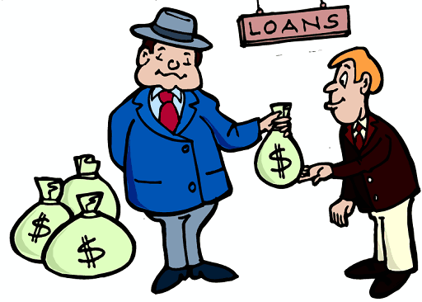
Operational Data (Data Comes In)
An account holder transfers money
A customer places an order
A loan is granted

Slide 6
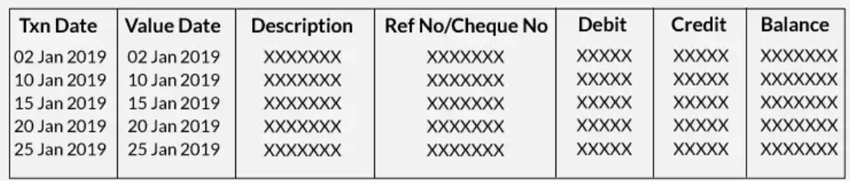
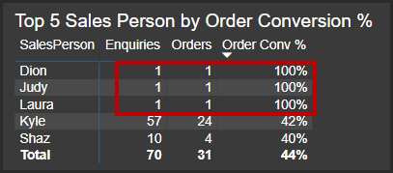
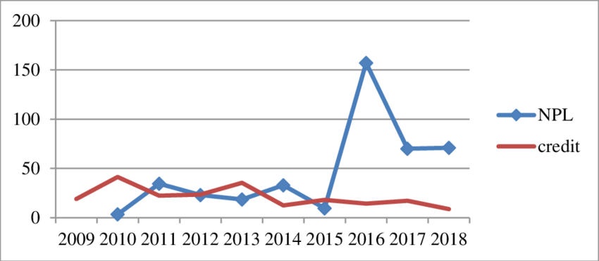
Analytical Data (Data Goes Out)
Last month money transfer history
Top 5 order conversions
Loans report

Slide 7
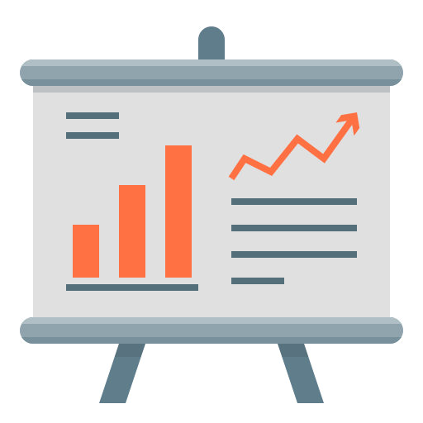

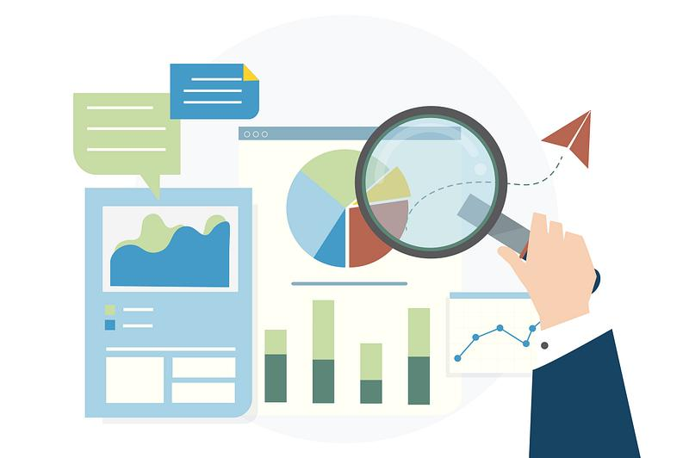
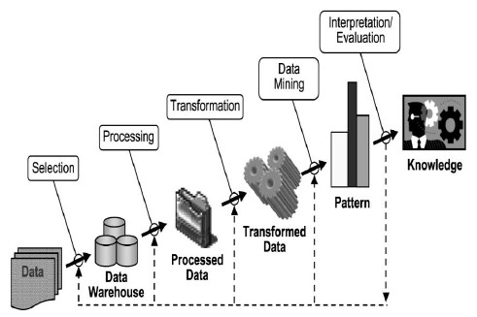
Data Warehousing to Data Analytics
CRM
Reporting
Data
Warehouse
Billing
E
T
L
Analytics
ERP
External data
Mining

Slide 8
Areas of Data-related Work

Slide 9
Data – What is There for Me?
Data
Engineering
(Infrastructure)
Data
Analytics
(Decisions)
Data
Science
(Modelling,
Product building)

Slide 10
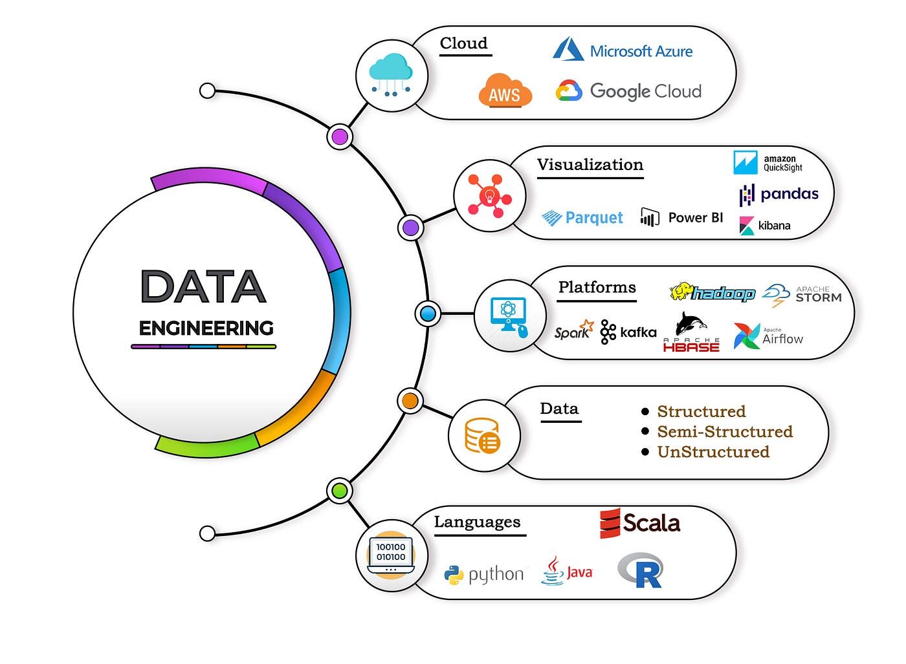
Data Engineering
Focus: Creating and maintaining infrastructure for Data Analysts and Data Scientists
Skills: Programming (Python/R), Apache Spark, Kafka, Databases (SQL/MongoDB), Linux Shell Scripting, Cloud (AWS), DevOps (Docker, Kubernetes, Jenkins, Git), ETL

Slide 11
Data Analytics
What happened?
What were the sales figures?
How many users registered?
How many subscriptions got cancelled?
Why did it happen?
Which products were sold the most?
Did we have more mobile users?
Did cancellations happen after watching a particular movie?
What is likely to happen?
What will the sale be in this quarter?
How many total users will we have?
Will subscription cancellation rate drop to 10%?
What action should we take?
How do we grow sales?
How do we get to 1M users?
How do we take the subscription cancellation rate to 5%?

Slide 12
Types of Data Analytics
Optimization, Decision trees
Descriptive analytics (Hindsight)
Diagnostic analytics
Predictive analytics (Insight)
Prescriptive analytics (Foresight)
Prescriptive Analytics
What is the best action?
Predictive Analytics
What will happen in the future?
Diagnostic Analytics
Why did it happen?
Forecasting, Data mining, Regression, Simulations
Descriptive Analytics
What happened in the past?
Dashboards, Business intelligence

Slide 13
Descriptive Analytics
The use of data to understand past and current business performance and make informed decisions
Examples
Customer basket analysis – Shopping patterns, Associations between products using Apriori algorithm
Movie review sentiment analysis

Slide 14
Diagnostic Analytics
Why something happened?
Examples
Credit card fraud detection using classification
Compare performance of two ML models (A/B Testing)

Slide 15
Predictive Analytics
Predict the future by examining historical data, detecting patterns or relationships in these data, and then extrapolating these relationships forward in time.
Examples:
Predict whether a customer will churn at HDFC Bank
Predict next year sale for Walmart

Slide 16
Prescriptive Analytics
Uses optimization to identify the best alternatives to minimize or maximize some objective.
Examples:
From a million songs on YouTube, predict the song(s) that an individual will like
Analyze historical sale data, customer behavior, market trends etc to recommend the price level for a soap manufactured by HLL

Slide 17
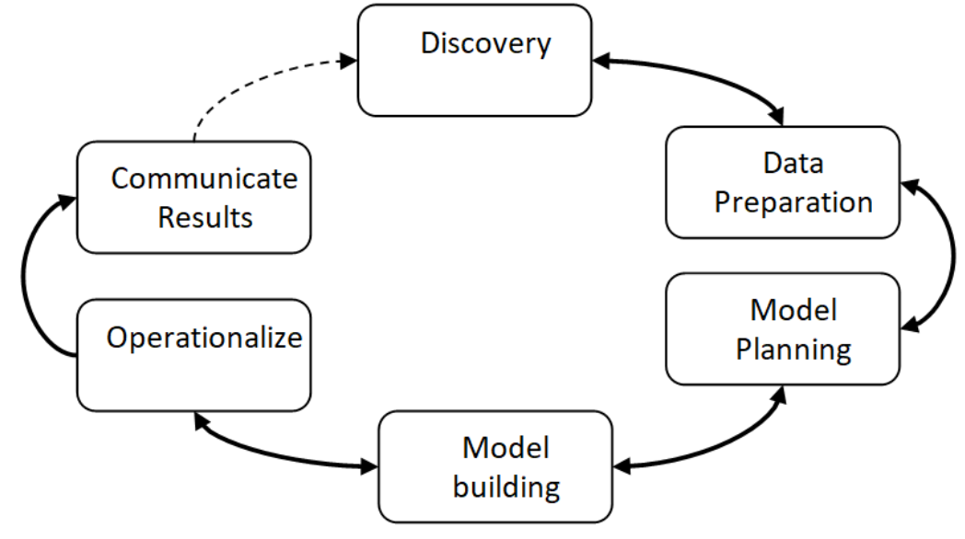
Data Analytics Life Cycle
Data Analytics Lifecycle defines the roadmap of how data is generated, collected, processed, used, and analyzed to achieve business goals.

Slide 18

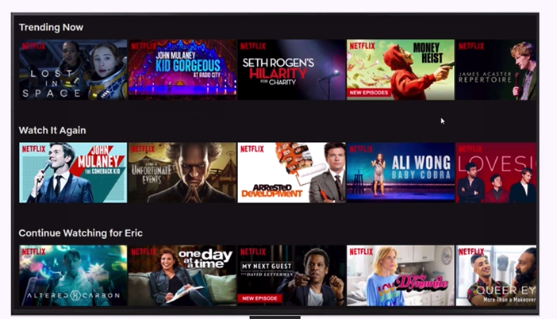
Data Science
Focus-1: Advanced statistical modelling (e.g. Machine learning, Time series analysis, Decision tree-based techniques, Bayesian networks, etc) – Focus is always on the future
Focus-2: Build data products

Slide 19
Python Data Science: NumPy, Pandas, MatplotLib, Seaborn, ScikitLearn

Slide 20
NumPy
NumPy is the base for everything in Python Data Analytics
Python library for creating N-dimensional arrays
Similar to Python lists, but much more efficient
Ability to quickly broadcast functions (No need to do element-by-element operations on arrays)
Example:
arr = np.array([1, 2, 3, 4])
scalar = 10
result = arr + scalar
Built-in linear algebra, statistical distributions, random number capabilities

Slide 21
NumPy Arrays
Main ways of creating a NumPy array:
Transform Python list
Use built-in functions
Generate random data
Indexing and Selection: Single element, Slicing, Broadcasting, 2D indexing and selection, Conditional selection
Operations on arrays: Arithmetic, Universal functions, Summary statistics, 2D arrays
Code: C:\code\Data Analytics\numpy

Slide 22
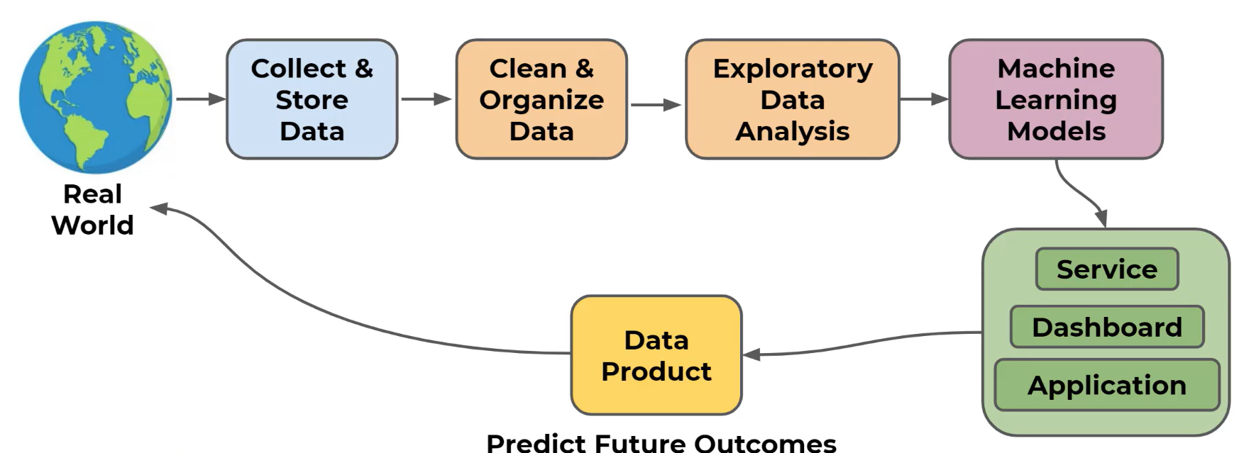
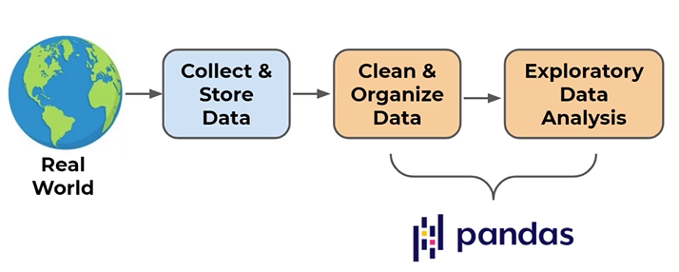
Pandas

Slide 23
Pandas
Pandas: Library for Data Analysis
Extremely powerful and flexible table (DataFrame) system built on top of NumPy
Computationally very efficient
Features
Read/Write data – Many formats supported
Indexing, Applying logic, Sub-setting, etc
Handle missing data
Adjust and restructure data

Slide 24
Pandas: Main Topics
Series and DataFrames
Conditional filtering and useful methods
Missing data
Grouping operations
Combining dataframes
Text methods and Time methods
Inputs and Outputs

Slide 25
Series (C:\code\Data Analytics\pandas\1_pandas_series.py)
Series: A data structure that holds an array of information along with a named index
The named index distinguishes it from a NumPy array
NumPy array has numeric index
Pandas series has a labelled index
Note: Data is internally still numerically organized!
Index | Data
0 | 1776
1 | 1867
2 | 1821
Labelled Index | Data
USA | 1776
Canada | 1867
England | 1821
Numeric Index | Labelled Index | Data
0 | USA | 1776
1 | Canada | 1867
2 | England | 1821
Finding data using this index is not easy
Finding data using this index is very easy
We can still use the numeric index, if we want

Slide 26
DataFrame
DataFrame: Table of columns and rows that can be easily restructured/filtered
So, Dataframe = Several series that share the same index, like a spreadsheet
Series
Multiple Series with the Same Index
Dataframe
Index | Year
USA | 1776
Canada | 1867
England | 1821
Index | Year
USA | 1776
Canada | 1867
England | 1821
Index | Pop
USA | 328
Canada | 38
England | 126
Index | GDP
USA | 20.5
Canada | 1.7
England | 3.9
Index | Year | Pop | GDP
USA | 1776 | 328 | 20.5
Canada | 1867 | 38 | 1.7
England | 1821 | 126 | 3.9

Slide 27
DataFrame
Basic operations
Create a dataframe
Select a column/multiple columns
Select a row/multiple rows
Insert a new column/row
Advanced Operations
Indexing
Filtering
Missing data
Grouping
Joining

Slide 28
MatplotLib
Data visualization is very important to quickly understand trends and relationships in the data
Matplotlib: One of the most popular plotting libraries in Python
Grandfather of plotting and visualization libraries in Python
Seaborn/Pandas built-in visualization are built on top of Matplotlib
Heavily inspired by the plotting functions in the MatLab programming language
Almost any type of plot can be created and customized
Can be confusing at first: Two approaches: (1) Functional (2) OOP
Maplot basics: Functional, Figures and subplots: OOP
Main goals
Plot a functional relationship, e.g. y = 2x
Plot a relationship between raw data points: x = [1, 2, 3, 4] and y = [2, 4, 6, 8]

Slide 29
Seaborn
Seaborn: Statistical plotting library specifically designed to interact with Pandas DataFrames to create common statistical plots
Built on top of Matplotlib, but uses a simpler one-line syntax
Easy to use, but less customization possible as compared to Matplotlib
Example: sns.scatterplot(x=‘division’, y=‘sales’, data=df)
Types of plots
Scatter plots: How are different features related to one another?
Distribution plots: How is data distributed?
Categorical plots
Comparison plots
Seaborn grids
Matrix plots

